Slide 1
RECLAIMING LOST GROUND
A Research Collaboration between the Department of Transport and Main Roads, University of Queensland & Delft University of Technology, 2017-2021

Slide 2
Research Objective
Identify the potential of road space sharing for all users
Examine the role and influence of parking in urban mobility, transport preferences, and site choices, and how emerging technologies (e.g., eScooters, ride-hailing, MaaS, bay-sharing, cloud kitchens, and the sharing economy) and mobility trends (e.g., car ownership decline and active transport rise in the more developed countries) are disrupting the role and influence of parking.

Slide 3
Research Elements
A university and government research collaboration to explore and compare four elements of car parking in three cities (Brisbane, Sydney and Melbourne)
1. How planning initiatives, emerging mobility technologies, and travel behaviors influence the supply, demand, and location of parking.
2. How parking policy and availability influence transport preferences and travel behaviours.
3. Land use and transport planning guidelines that minimize and repurpose the high value public space that is reserved for storing immobile private vehicles.
4. Scenarios that take current mobility trends into account.

Slide 4
Boundary Street, West End
Primary Research
i.e., public forum, visitor and on-street parking surveys
Urban Mobility Review
i.e., review of the research and grey literature
Road Sharing Options for West End

Slide 5
Summary of Urban Mobility Policy Review
The Brisbane Parking Taskforce’s city-wide parking review (2014) identified 55 recommendations to better cater for the multiple demands on curb-side road space
Key themes included:
Removing on-street car parking in the Central Business District during peaks to increase traffic flow
Lowering off-street parking rates during the off-peaks activate the centre
Increasing and varying paid on-street parking regimes
Limiting residential parking permits for new developments
Enhancing parking signage and enforcement
Leveraging parking technologies including open-access parking data

Slide 6
Summary of Urban Mobility Policy Review
Brisbane, Sydney, and Melbourne each have policies to transition gradually from the “predict and provide” approach towards the multimodalism and demand management approaches
These cities are improving urban mobility by:
(1) improving the viability, convenience, and safety of public and active transport to relieve private transport dependencies;
(2) concentrating residential development within walking distance of rapid transit nodes to further relieve private transport dependencies;
(3) restricting parking supply in areas well-serviced by public transport to minimise the appeal of private transport;
(4) charging motorists for public parking so that the public expense is reflected in their transport choices; and
(5) developing park `n’ rides so that the private transport dependent have the opportunity to access rapid public transit, and to avoid encountering and contributing towards traffic congestion.

Slide 7
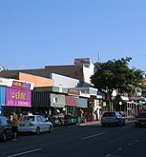
West End Case Study
The four elements (earlier slide) are applied to Boundary Street West End as a case study
Mixed-research methods:
public forum (3/2/2018)
visitor intercept survey (7/10/20 & 10/10/20 from 7:00-21:00).
parking turnover survey (as above)
Full West End case study results and research publications are available online (parks-uq.github.io)
This Photo by Unknown Author is licensed under CC BY-SA

Slide 8
Boundary Street, West End
Primary Research
i.e., public forum, visitor and on-street parking surveys
Urban Mobility Review
i.e., review of the research and grey literature
Road Sharing Options for West End

Slide 9
Policy Context/Situation Analysis
West End has several unique characteristics:
peninsula community;
high residential demand;
Brisbane State High School catchment area;
West End State School capacity expansion and the new high school at Dutton Park (ICSSSC);
development cycle – medium and high density residential; infill development and established homes;
highly engaged and active community;
dedicated active travel routes;
high frequency bus service (to CBD); & CityGlider bus service linked to ferry services.
The pandemic has impacted local mobility, demand for neighbourhood services and experiences, reduced patronage of public transport, increased private car use, and altered commute patterns

Slide 10
Policy Context/Situation Analysis
Key transport, mobility, and active travel initiatives include:
The Brisbane Metro;
2 proposed green bridges i.e., West End-University of Queensland & West End-Toowong;
South Brisbane Transport and Mobility Study Insights Report (DTMR) November 2019 - consultation completed Sept – Nov 2018 revealing a high resident frustrations with ‘people using their street for car parking’.
Move Safe Brisbane (BCC Citywide Pedestrian Safety Review) 2018 installation of new pedestrian crossings after sustained community action.
The 2020 project West End case study surveys are built from feedback received during the 2018 public forum

Slide 11
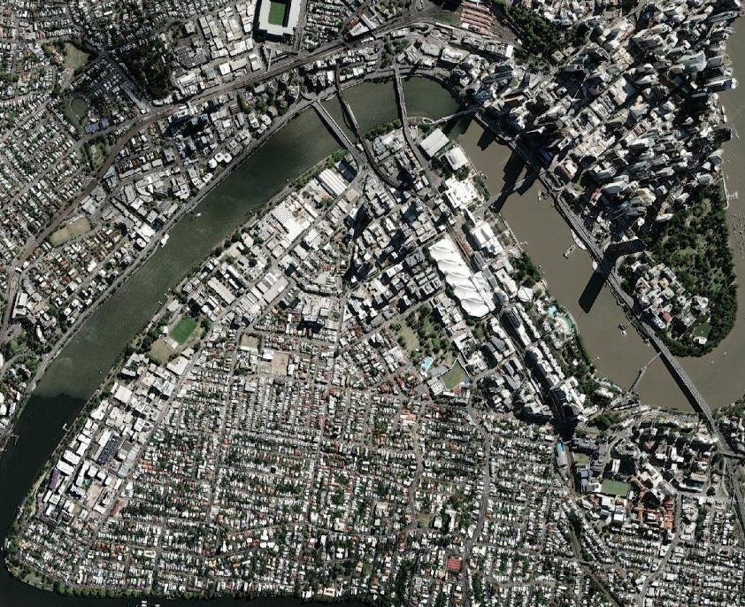
CBD
The Boundary St, West End Metropolitan Context
A peninsula suburb transitioning from medium to high density mixed-use.
A resident community known for promoting a ‘green‘ lifestyle.
Heritage protection to maintain low rise, smaller retail, food and entertainment outlets.
An inner city, metropolitan destination for lifestyle, food, culture.
Contentious on-street parking given that private transport and greener transport are competing for narrow road space and turning areas.
Social conflict between visitors, residents, and traders, and the high-rise newcomers and the established residential community.
Annual Boundary Street party where the street is closed to private transport and showcases other uses/users of the road space.
Boundary St Case Study

Slide 12
West End case study: mixed methods research
Saturday (3/2/2018) a four-hour public forum ‘Should we replace street parking with bike lanes?’ at AHEPA Hall, Boundary St, West End.
Wednesday (7/10/20) and Saturday (10/10/20) visitor intercept survey from 7am until 9pm
Revealing how visitors reached Boundary Street (i.e., 104 active, 86 public, and 24 private transport respondents), why this transport was preferred, where they live, their employment status, profession, age, gender, visit purpose(s), time spent, spending amount, perception of how others reached this location.
Also Wednesday (7/10/20) and Saturday (10/10/20) on-street parking turnover survey from 7am until 9pm
Revealing parking demand, turnover, and driving distance (from registrations) for the 54 marked on-street parking bays.

Slide 13
Visitor intercept survey summary*
Wednesday
Saturday
Active
Main purpose is shopping
Average spend is $24
Public
Main purpose is shopping
Visit lasts for 3hrs
Drive
Main purpose is dining
Visit lasts for 1.5hrs
Average spend is $24
Average spend is $23
Visit lasts for 2hrs
Distance travelled is 1.4kms (average)
Distance travelled is 5.5kms (average)
Distance travelled is 8kms (average)
Before 9am and 3pm peaks
After 3pm peak
Before 3pm and after 7pm peaks
active
Main purpose is dining
Average spend is $40
Public
Main purpose is shopping
Drive
Main purpose is dining
Visit lasts for approx. 2hrs
Average spend is $43
Visit lasts for approx. 2hrs
Average spend is $69
Visit lasts for approx. 2.5hrs
Distance travelled is 0.9kms (average)
Distance travelled is 19.7kms (average)
Distance travelled is 3.8kms (average)
Relatively uniform throughout the day
Relatively uniform throughout the day
3pm onwards peak
* Full results and research publications are available online (parks-uq.github.io)

Slide 14
Parking turnover survey summary*
Wednesday
Saturday
26% of vehicles parked were registered within 2km of Boundary suggesting local visitors
Parking demand typically remained below 50% except from 10:30-14:00, 16:00-17:00, and particularly after 6pm (~70%)
28% on Saturday were registered within 2km of Boundary suggesting local visitors
Saturday parking demand typically remained between 50% and 80% except after 19:30 (~ 83%)
Similar distance travelled on both days
The international research community regards <80% occupancy as best practice to minimise cruising for parking.
Parking demand is higher on Saturdays than Wednesdays
Some parking durations greatly exceeded 2hour limits
* Full results and research publications are available online (parks-uq.github.io)

Slide 15
Key West End case study findings
Weekday shoppers typically choose active or public transport whereas diners typically choose private transport and travel further.
Peak periods differ according to modal choice and appear associated with the school collection period (~3pm) and evening dining (after 6:30pm)
~1/3 of visitors arriving by private vehicle reside within 2km of Boundary St and public forum and qualitative findings suggests this is because walking is unappealing due to the lack of shade and number of crossing required (e.g., Montague Rd is a prominent example that divides the new river-front residential development from Boundary St)
Parking durations often exceeded the 2hour restrictions
Qualitative findings reveal that parking availability informs modal choices

Slide 16
Key West End case study findings
Research Element | Case Study finding
How planning initiatives, emerging mobility technologies, and travel behaviors influence the supply, demand, and location of parking. | Not the focus of the West End case study although arrival by ride-hailing or eScooters was surprisingly uncommon while other active transport were surprising common Current parking meters reveal expiry time rather than actual departure or bay unsuitable for parking-finder applications
How parking policy and availability influence transport preferences and travel behaviors. | Local visitors chose active and public transport in anticipation of parking unavailability. Diners travelled further and typically by private transport Visitors (and particularly traders) ignored 2P restrictions by large margins and sometimes on both days.

Slide 17
Key West End case study findings
Research Element | Case Study finding
Land use and transport planning guidelines that minimize and repurpose the high value public space that is reserved for storing immobile private vehicles. | West End and Highgate Hill Resident Parking Permit Area – residents are ineligible for resident parking permit for unregulated on-street parking if they reside in a multiple dwelling, apartment or student accommodation that was approved for development after 22 March 2019.
Scenarios that take current mobility trends into account | Coming up next

Slide 18
Car Parking/Mobility Possibilities for West End

Slide 19
Further Research
Temporary trials:
buildouts with ‘parklets’, dining spaces, and food trucks etc.
cycling clearway (single kerb) during low demand periods
shared space
Simulations to reveal how road capacity changes will impact traffic flows
Redeploy the UQ/DELFT research method to other Brisbane ‘high streets’ with similar competition for road space e.g., Toowong, New Farm, Bulimba, Fortitude Valley (James Street).

Slide 20




Research Partners
For further information: Dr Anthony Kimpton a.kimpton@uq.edu.au and Prof Jonathan Corcoran jj.corcoran@uq.edu.au

